Slide 1

Predicting Cardiovascular Heart Disease
Caitlin Jansson
March 23, 2021
Milestone Report

Slide 2
TABLE OF CONTENTS
Problem Statement
Dataset
Features Investigated
Initial Findings
Conclusions
References
Thanks
Appendix - Additional Figures

Slide 3

PROBLEM STATEMENT
Cardiovascular heart disease (CHD) is the leading cause of death annually worldwide.
Cardiovascular diseases can be managed if caught early and simple lifestyle changes are made.
The intent of this project is to explore a set of data for patients measuring known factors for heart disease to:
Develop a machine learning model to predict risk of developing heart disease within the next ten years.
Develop insights regarding CHD by exploring patient data
Make recommendations for a patient reeducation program to reduce risk of developing CHD

Slide 4
THE DATASET
This dataset is a subset of the Framingham, MA heart study data set.
This data consists of a large group of initially “healthy” patients between the ages of 30-59 who were then tracked for 20 years to determine if they developed CHD
The subset of data utilized contains information on over 4,200 patients.
43% Male
50.5% Nonsmokers
Patients ranging 32-70 years old
Find the Data Here: https://www.kaggle.com/christofel04/cardiovascular-study-dataset-predict-heart-disea

Slide 5
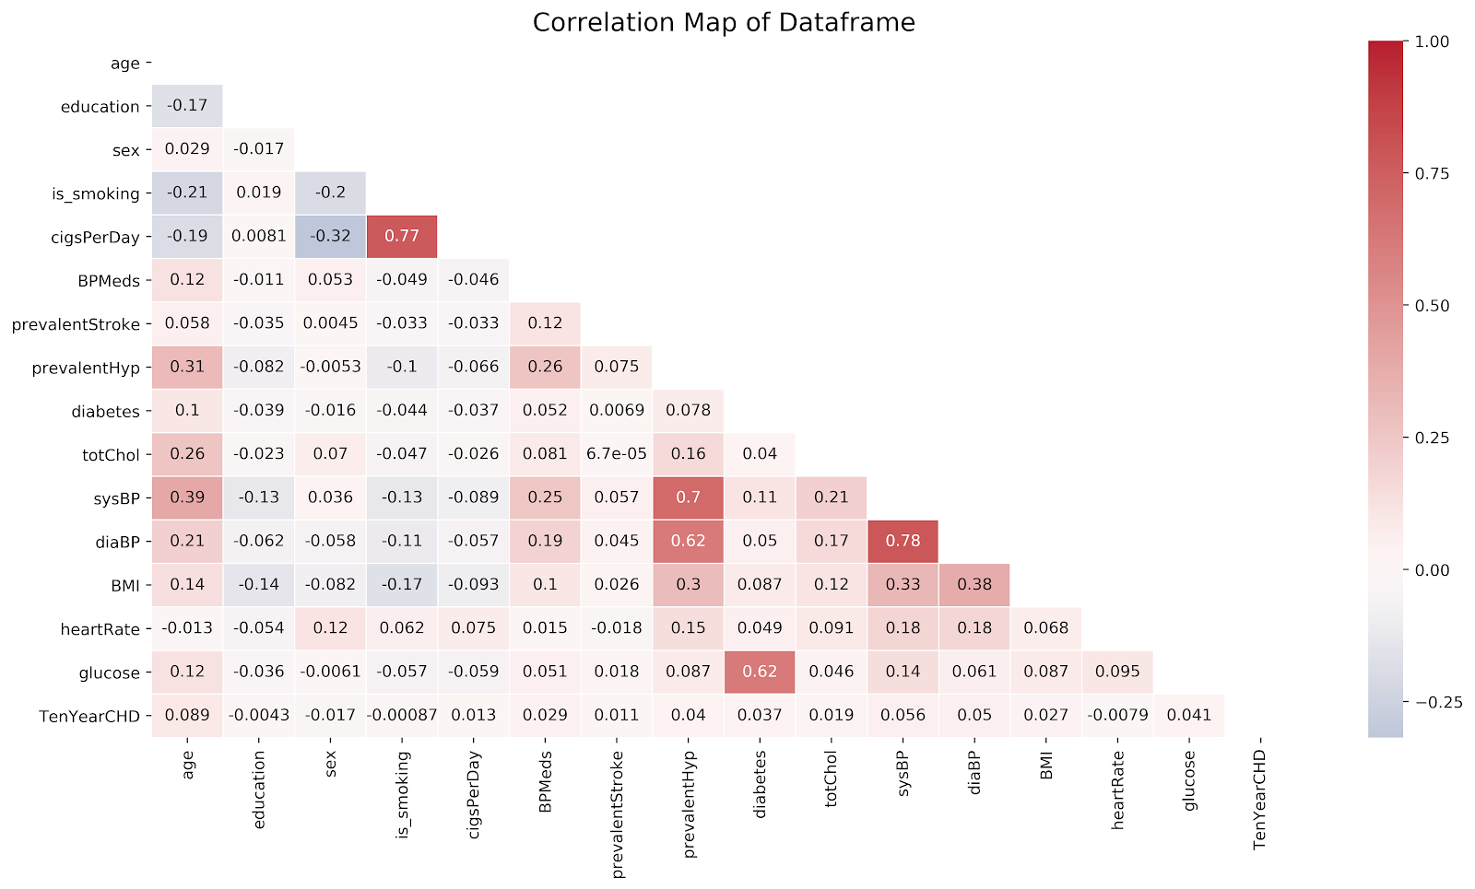
FEATURES INVESTIGATED
Age
Education Level
Gender
Smoker vs Nonsmoker
# of cigarettes smoked daily
Prevalence of
Stroke
Hypertension
Diabetes
Cholesterol
Blood Pressure
BMI
Heart Rate
Blood Sugar

Slide 6
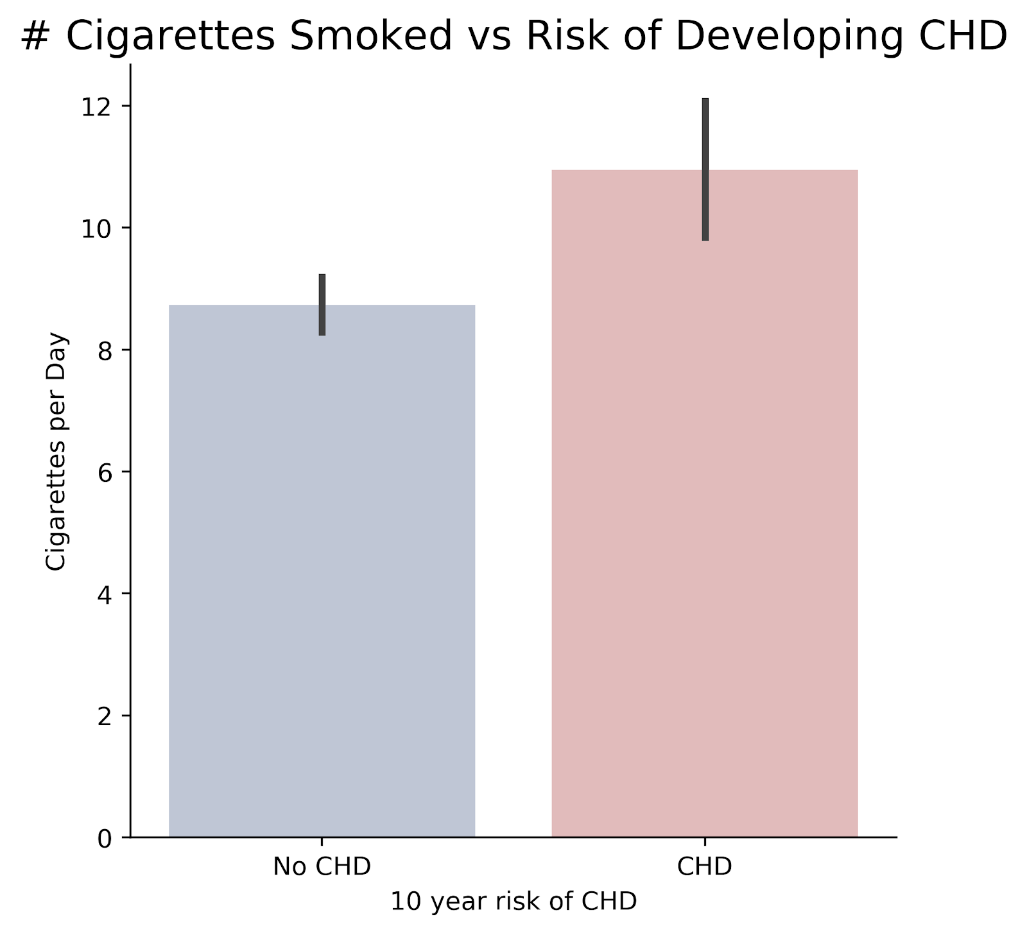
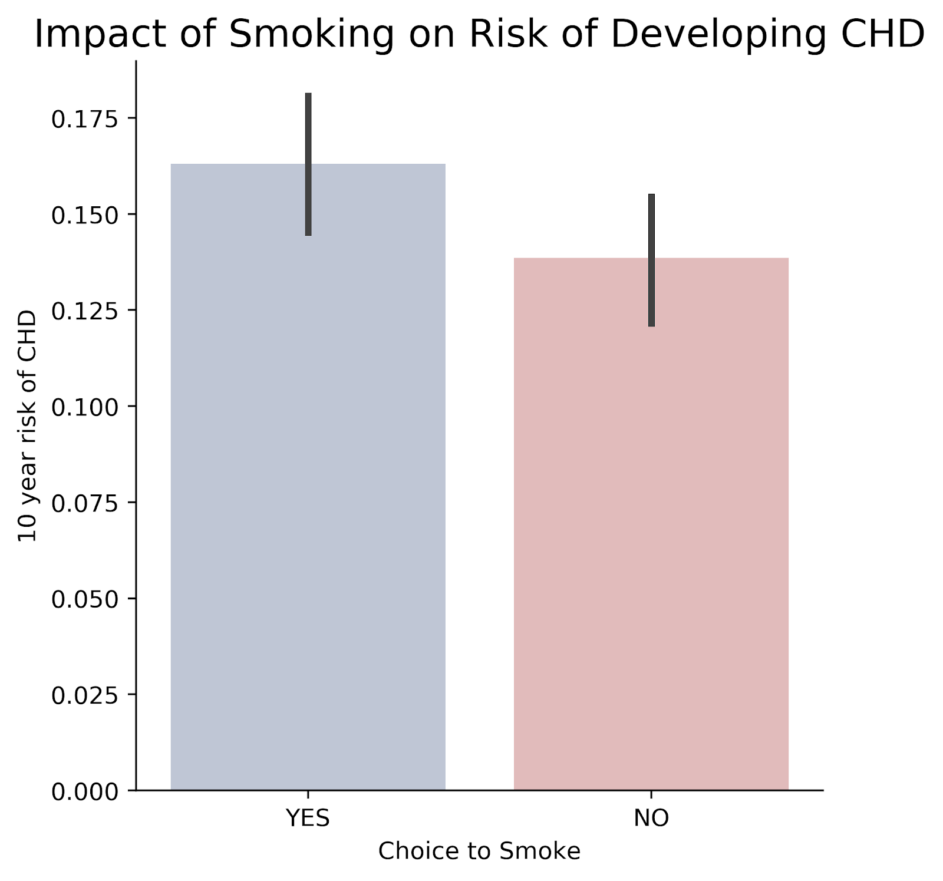
INITIAL FINDINGS: Smoking and CHD

Slide 7
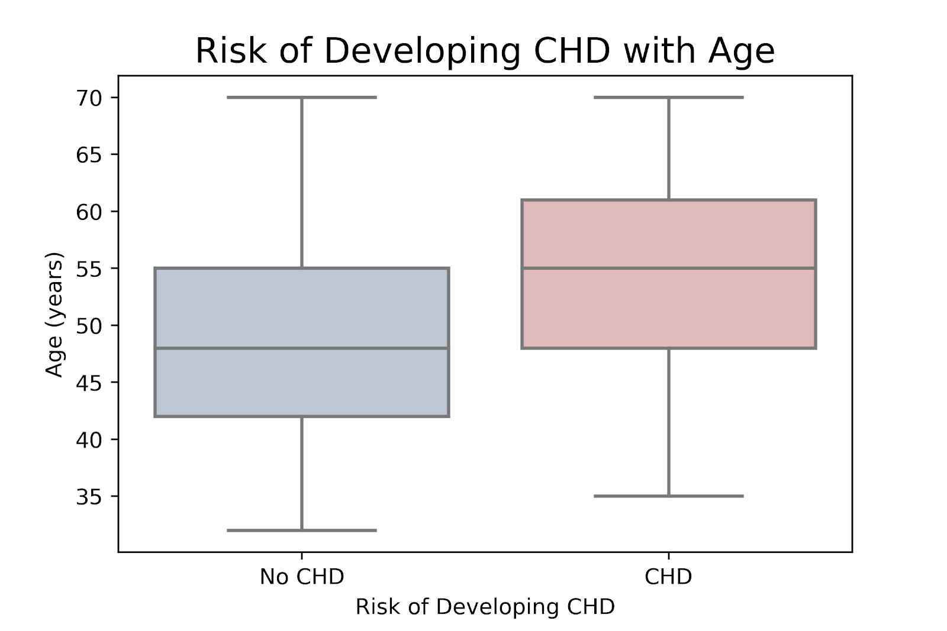
INITIAL FINDINGS: AGE AND CHD

Slide 8
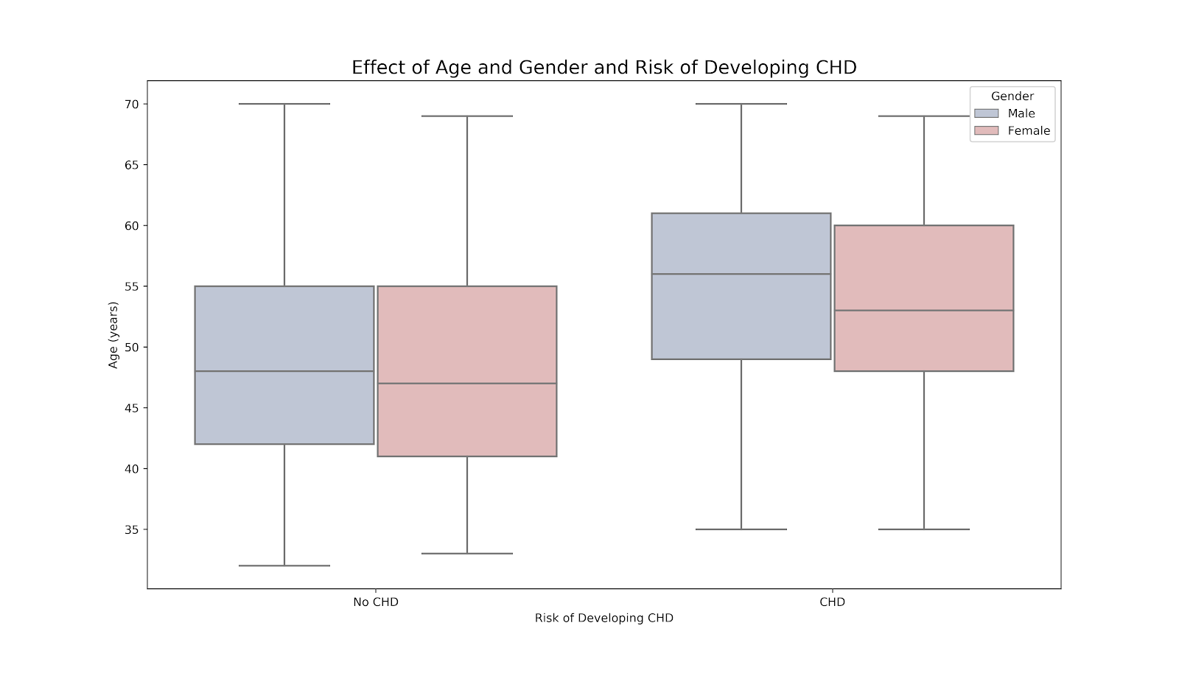
INITIAL FINDINGS: AGE, GENDER AND CHD

Slide 9
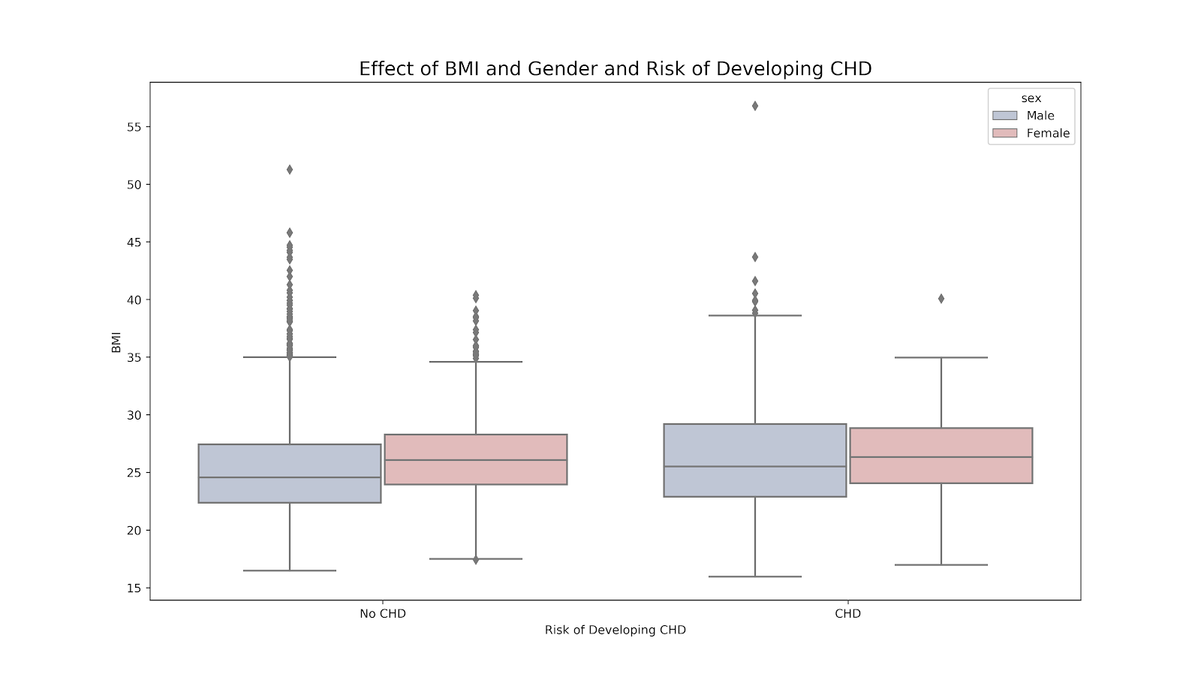
INITIAL FINDINGS: BMI, GENDER AND CHD

Slide 10
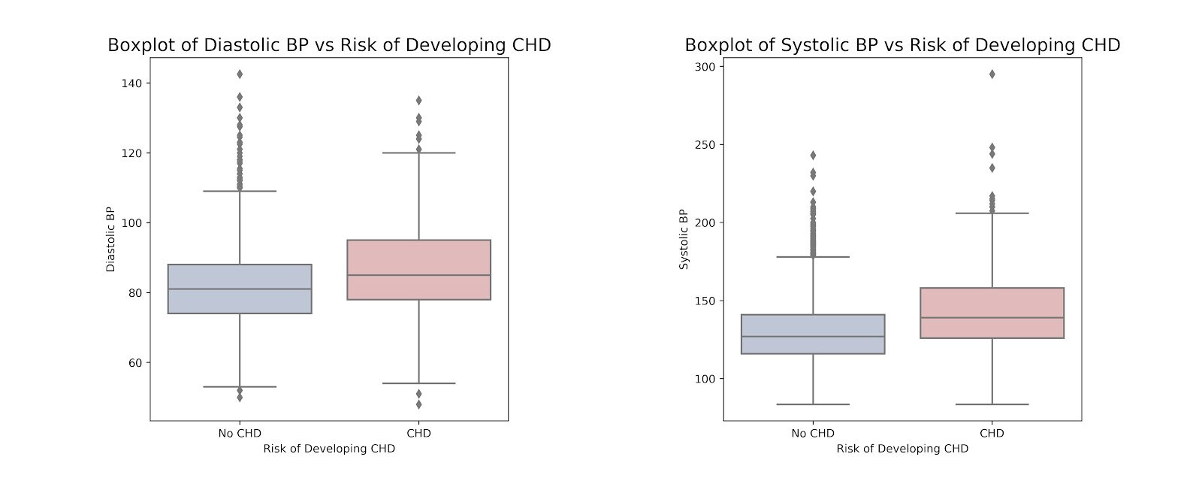
INITIAL FINDINGS: BLOOD PRESSURE AND CHD

Slide 11
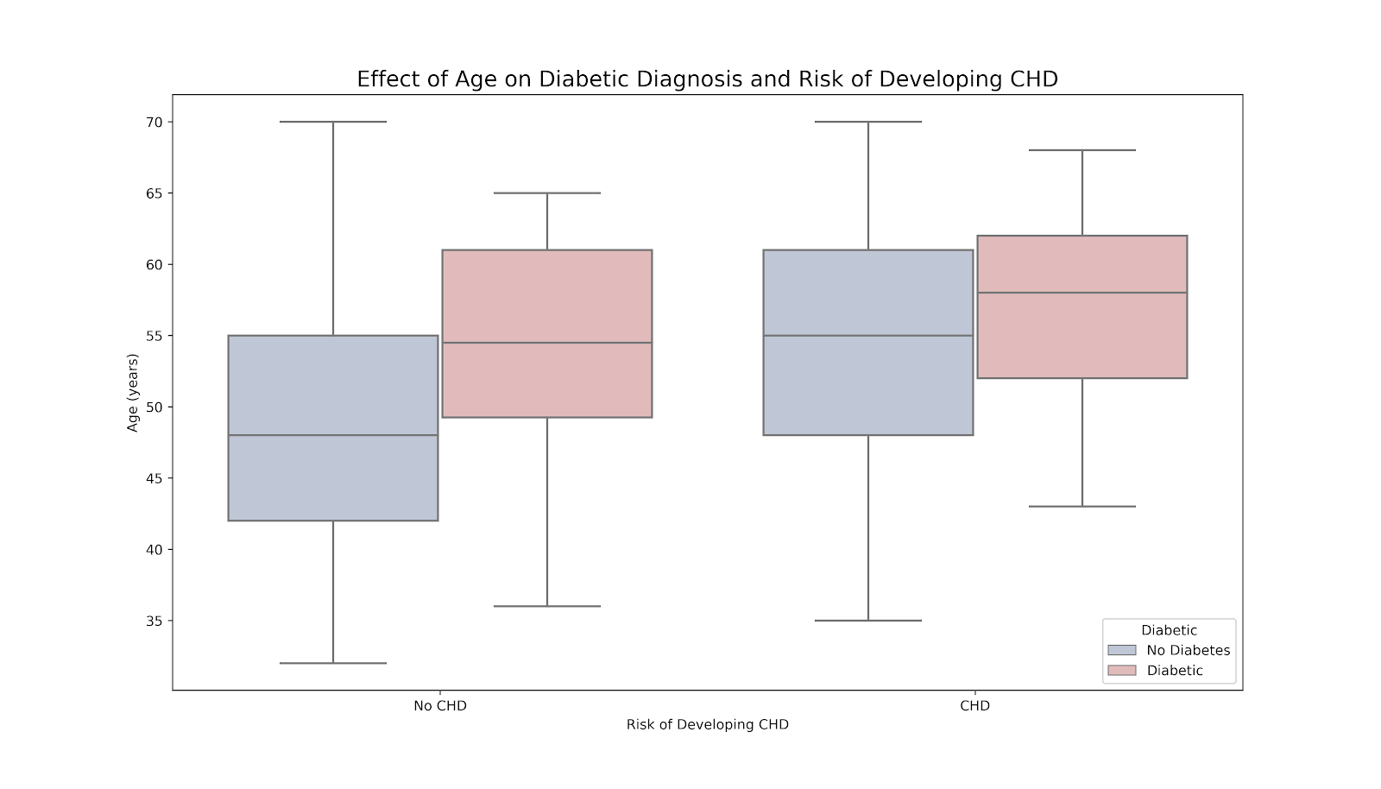
INITIAL FINDINGS: AGE, DIABETES AND CHD

Slide 12
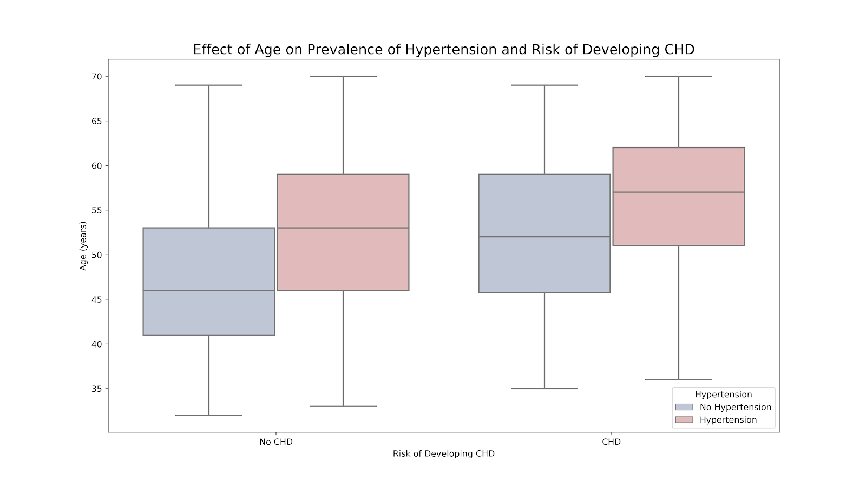
INITIAL FINDINGS: AGE, HYPERTENSION AND CHD

Slide 13
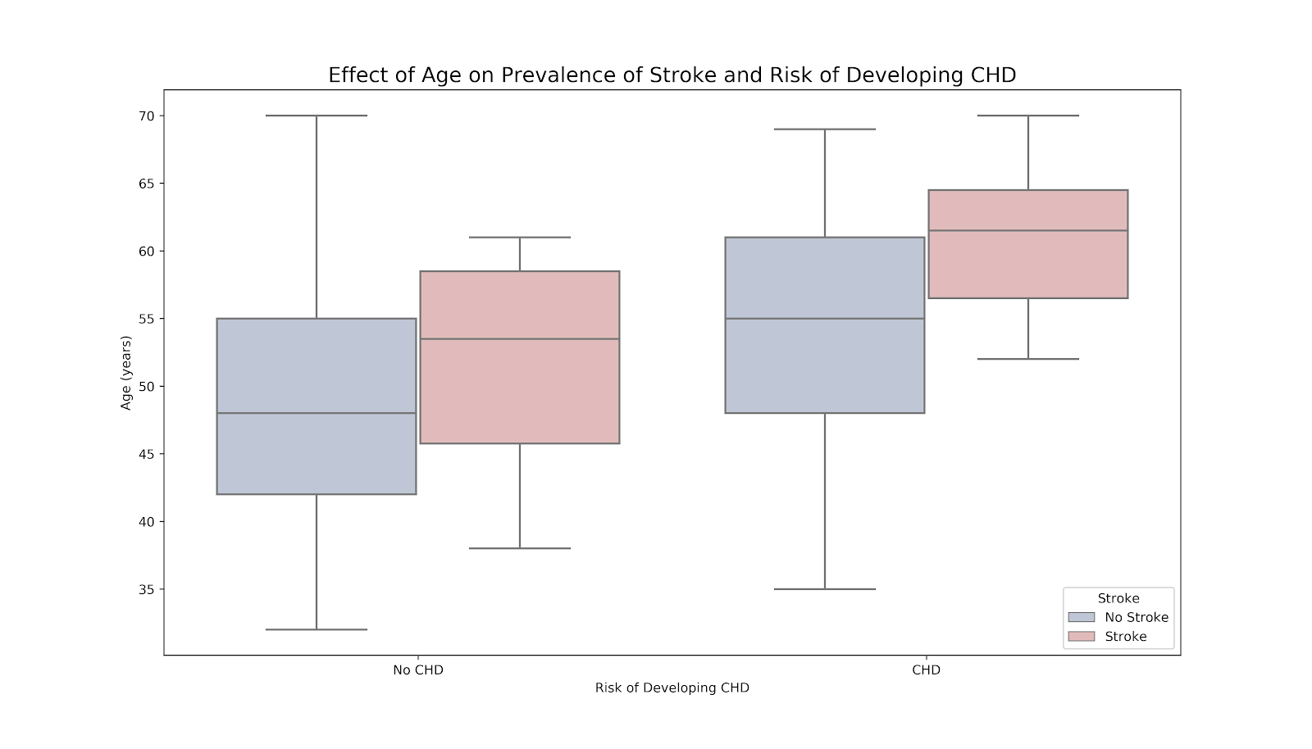
INITIAL FINDINGS: AGE, STROKE AND CHD

Slide 14
CONCLUSIONS
The risk of developing Cardiovascular Heart Disease is increased with:
Smoking, the more a patient smokes the higher the risk.
Cholesterol, and higher cholesterol means higher risk.
Blood Pressure
Prevalence of Stroke
Prevalence of Hypertension
Diabetes

Slide 15
CONCLUSIONS
Patient groups at highest risk, to target with reeducation material include:
Patients over 50
Males
Patients who smoke
Patients with diabetes and hypertension.

Slide 16
CONCLUSIONS
Recommendations for reeducation material:
Managing diet and exercise to reduce blood pressure, manage blood sugar, manage weight can reduce risk!
Cutting back on smoking can reduce risk: even if the patient only reduces consumption.

Slide 17
REFERENCES
https://www.thelancet.com/journals/lancet/article/PIIS0140-6736%2813%2961752-3/fulltext
https://web.archive.org/web/20170710152157/https://www.framinghamheartstudy.org/index.php

Slide 18

THANKS
Does anyone have any questions?
caitlinjejansson@gmail.com
https://github.com/CJEJansson/Springboard_Projects

Slide 19
APPENDIX

Slide 20
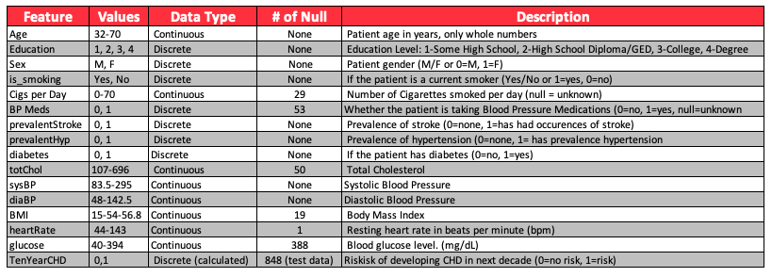
SUMMARY OF DATASET BY FEATURE

Slide 21
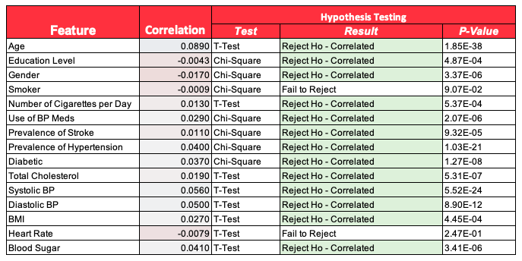
SUMMARY OF STATISTICAL ANALYSIS BY FEATURE

Slide 22
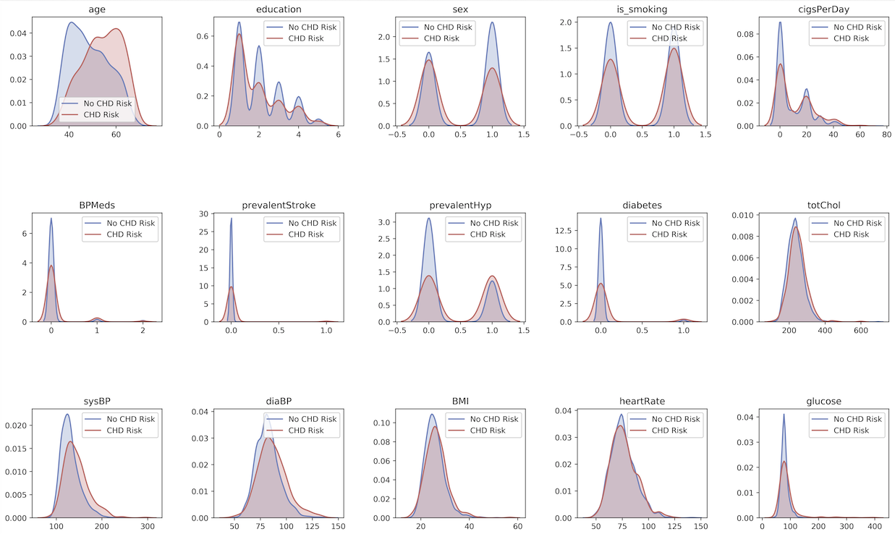
KDE Distributions by Feature vs Risk of Developing CHD

Slide 23
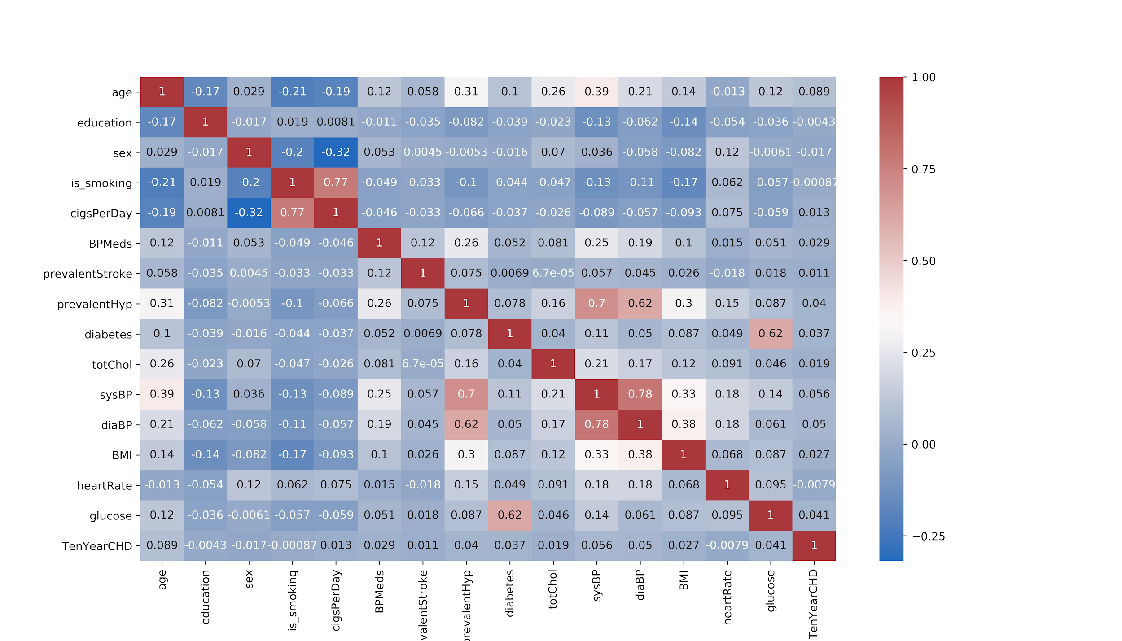
Full Correlation Heatmap

